Slide 1


ALTSCHOOL OF Cybersecurity (BARAKA 2025)
MONTH 2 – WEEK 5

Slide 2
REFRESHER – LAST WEEK
Overview Legal Frameworks
  Introduction to key Legislation and Regulations (GDPR, HIPAA, CCPA, etc.)
    Importance of Data Protection and Privacy Laws
    The growing need for compliance in a digital world
    Understanding Data Privacy & Security Regulation
  Compliance Requirements and Standards
  Intellectual Property and Copyright Laws
Ethical Hacking
  Introduction to Ethical Hacking

Slide 3
Month 2 - WEEK 5 (Day 1)
Risk Management
  Overview of Identifying Risk and Type of Risk
  Risk Identification Techniques
  Accessing Risk and Prioritizing Risk
  Mitigating Risk Monitoring and Communicating in Risk Management
  Risk Management Frameworks – Overview
  Importance of Risk Management Frameworks and Primary Components of RMFs
  Top Risk Management Frameworks Today.
  Benefits of Risk Management Frameworks and Framing your Risks
Introducing Key Legislations and Regulations, Compliance Requirements and Standards
  Introduction to Key legislations and Regulations (GDPR, HIPAA, NDPA, CCPA, etc)
  Compliance Requirements and Standards
  Examples of Cybersecurity Standards (ISO 27001, PCIDSS, NIST)

Slide 4
Risk Management

Slide 5
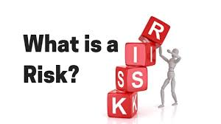
RISK
Risk can be defined as a probability of the occurrence of a threat or an event that may damage, or cause loss or have other negative impact either from internal or external liabilities.

Slide 6
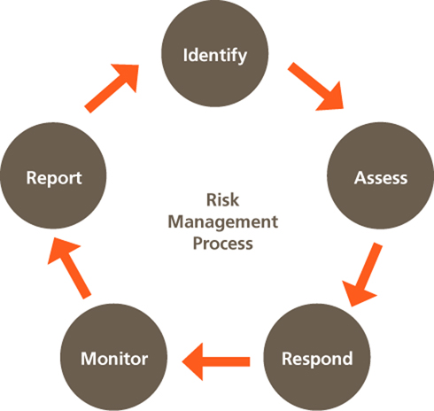
RISK MANAGEMENT
Risk management is the process of identifying, assessing, and mitigating risks that could impact an organization's objectives. It helps businesses minimize threats while maximizing opportunities.
In Cybersecurity security, risk management involves protecting systems, data, and networks from cyber threats.

Slide 7

TYPES OF RISK
Strategic Risks
These are risks that arise from an organization’s business strategy and objectives. For example, entering a new market or launching a new product may have strategic risks associated with them.

Slide 8
TYPES OF RISK
Operational Risks
These are risks that arise from an organization’s day-to-day activities and processes. Examples include technology failures, employee errors or supply chain disruptions.

Slide 9
TYPES OF RISK
Financial Risks
These are risks that arise from an organization’s financial operations and management. Examples include credit risk, market risk and liquidity risk.

Slide 10
TYPES OF RISK
Legal/Compliance Risks
These are risks that arise from an organization’s failure to comply with laws, regulations or industry standards. Examples include contract disputes, intellectual property disputes, employment law violations, data privacy violations or noncompliance with environmental regulations..

Slide 11
TYPES OF RISK
Reputational Risks
These are risks that arise from damage to an organization’s reputation, image or brand. Examples include product recalls, lawsuits or negative media coverage.

Slide 12
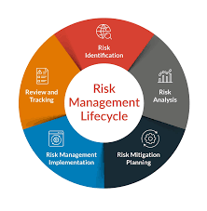
RISK Identification Techniques
Brainstorming
    This is the act of gathering team members to think about and discuss a subject and to form solutions to any identified problems. This kind of meeting allows a team to speculate on ideas, discuss facts and look at a project's future. You can use brainstorming to identify, analyze and address potential risks by hearing from people who work at the front end of the business. Team members may have a better understanding of how the business operates from the ground level and can share their own perspectives of the company's risks

Slide 13
RISK Identification Techniques
Stakeholder interviews
    Stakeholders are the people who have an interest in your project or business, and interviewing them may help you better understand what they believe are the biggest risks. Stakeholders often have invested significant resources, whether it be time, money, labor or all three, into your business. They understand risk from an outsider's perspective as an investor, not a laborer or leader.

Slide 14
RISK Identification Techniques
The NGT, or nominal group technique, is another method of brainstorming that offers a more in-depth approach to the subject. Participants write their own ideas about the challenge without discussing it directly with other group members. Then, a senior member of the team asks each participant for their thoughts, which are written on a chart or whiteboard with overlapping items removed..

Slide 15
RISK Identification Techniques
Affinity diagram
  An affinity diagram is a diagram that organizes data into categories based on their similarities. Ask each team member to write what they believe are potential project or company risks and file each response under a few categories. For example, you can have financial, practical or safety risks as categories. This helps separate the risks into categories for individual review and helps organize the feedback you receive. From there, the team can prioritize each risk and address it.

Slide 16
RISK Identification Techniques
Root cause analysis
  A root cause analysis is an investigation of previous project risks and how they relate to one another and the current project. The root cause can be anything from financial challenges to outdated equipment or poor-quality materials. Finding the root cause can allow the team to identify common challenges in the project or business and minimize them for greater project efficiency

Slide 17
RISK Identification Techniques
SWOT analysis
  SWOT, or strengths, weaknesses, opportunities and threats analysis, is a great way to understand a project's or business's risks alongside other important factors. A thorough SWOT analysis can show investors why a business or project is worthy of investment and helps the team better understand their efficacy in reaching goals. A SWOT analysis examines four factors:

Slide 18
RISK Identification Techniques
SWOT analysis
Strengths: Areas where the team excels and how they relate to projects.
Weaknesses: Areas where the team can improve to increase productivity and efficiency.
Opportunities: Areas where the team or business can improve or expand.
Threats: Areas of risk for the project or business and how the team can minimize those risks.

Slide 19
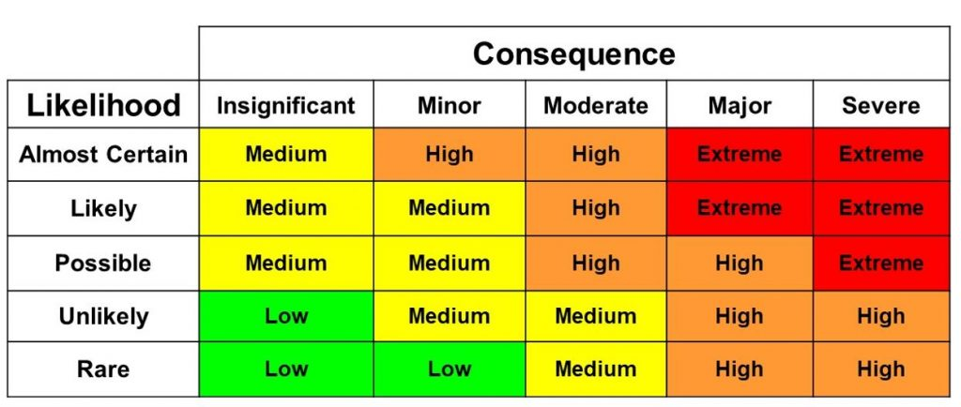
Accessing Risk and Prioritizing Risk
A risk matrix is used during risk assessment to define the level of risk by considering the category of probability or likelihood against the category of consequence severity..

Slide 20
RISK Management Frameworks – Overview
Identify, assess, and prioritize risks.
Implement effective risk mitigation strategies.
Ensure compliance with legal, regulatory, and industry standards.
Enhance decision-making through risk-informed insights.
Protect organizational assets, data, and reputation.

Slide 21
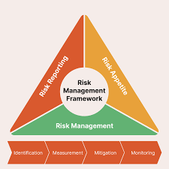
RISK Management Frameworks – Overview
Step 1: Risk Identification
Identify potential risks that could impact the organization.
Categorize risks into relevant domains:
  Strategic Risks – Business decisions, market changes.
  Operational Risks – Process failures, human errors.
  Financial Risks – Budget constraints, fraud.
  Compliance Risks – Legal, regulatory, contractual.
  Technology Risks – Cyber threats, system failures.
  Environmental Risks – Natural disasters, geopolitical issues.

Slide 22
RISK Management Frameworks – Overview
Step 2: Risk Assessment
Evaluate risks based on:
  Likelihood (Probability of occurrence: Low, Medium, High).
  Impact (Effect on business: Low, Medium, High).
  Risk Score = Likelihood × Impact.
Use a Risk Matrix to classify risks as Low, Moderate, High, or Critical.

Slide 23
RISK Management Frameworks – Overview
Step 3: Risk Mitigation & Response
Develop strategies to handle risks:
Avoid – Eliminate activities that generate the risk.
Reduce – Implement controls to lower likelihood/impact.
Transfer – Shift risk via insurance or outsourcing.
Accept – Acknowledge the risk if impact is manageable.

Slide 24
RISK Management Frameworks – Overview
Step 4: Risk Monitoring & Reporting
Continuously monitor risks through Key Risk Indicators (KRIs).
Establish periodic risk assessments (monthly, quarterly, annually).
Document risk management activities in risk registers.
Report risks to senior management and stakeholders.

Slide 25
Importance of Risk Management Frameworks and Primary Components of RMFs
Enhances Decision-Making
Provides a structured approach for evaluating risks before making strategic or operational decisions.
Helps leadership weigh risk against potential rewards.

Slide 26
Importance of Risk Management Frameworks and Primary Components of RMFs
Improves Compliance & Regulatory Adherence
Ensures compliance with industry standards and legal requirements (e.g., ISO 31000, NIST 800-37, COSO ERM, GDPR, PCI-DSS).
Reduces the risk of legal penalties and reputational damage.

Slide 27
Importance of Risk Management Frameworks and Primary Components of RMFs
Protects Organizational Assets & Reputation
Safeguards financial, intellectual, human, and digital assets from threats such as cyberattacks, fraud, or operational failures.
Maintains customer trust by proactively managing risks.

Slide 28
Importance of Risk Management Frameworks and Primary Components of RMFs
Enhances Business Resilience & Continuity
Prepares organizations to handle disruptions (e.g., cyber incidents, natural disasters, financial crises).
Ensures continuity of operations through risk mitigation and contingency planning.

Slide 29
Importance of Risk Management Frameworks and Primary Components of RMFs
Reduces Financial Losses
Identifies financial risks (e.g., fraud, investment risks, budget overruns) and implements controls to minimize monetary impact.
Supports cost-effective risk mitigation strategies.

Slide 30
Importance of Risk Management Frameworks and Primary Components of RMFs
Strengthens Cybersecurity & IT Governance
Essential for protecting data, IT infrastructure, and digital assets against cyber threats.
Helps in implementing security controls (e.g., firewalls, encryption, access controls) aligned with regulatory standards like NIST, ISO 27001, CIS Controls.

Slide 31
Importance of Risk Management Frameworks and Primary Components of RMFs
Fosters a Risk-Aware Culture
Encourages proactive risk identification at all organizational levels.
Empowers employees to make informed decisions about risk exposure in their daily activities.

Slide 32
Importance of Risk Management Frameworks and Primary Components of RMFs
Enables Continuous Monitoring & Improvement
Establishes a risk register and key risk indicators (KRIs) for ongoing monitoring.
Allows organizations to adapt risk strategies based on evolving threats.

Slide 33
Importance of Risk Management Frameworks and Primary Components of RMFs
Supports Strategic Growth & Innovation
Enables businesses to take calculated risks in new ventures (e.g., entering new markets, adopting new technologies).
Ensures that risks associated with growth are identified and managed.

Slide 34
Importance of Risk Management Frameworks and Primary Components of RMFs
Builds Investor & Stakeholder Confidence
Demonstrates to investors, board members, and stakeholders that risks are actively managed.
Enhances credibility and supports sustainable business operations.

Slide 35
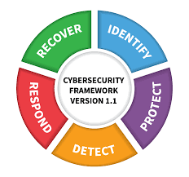
TOP - Risk Management Frameworks
NIST Risk Management Framework (RMF)
Best For: Cybersecurity, IT Governance, Government & Defense Organizations
Developed by the National Institute of Standards and Technology (NIST).
Integrates security, privacy, and cyber risk management into organizational processes.
Follows a 7-step process: Categorize, Select, Implement, Assess, Authorize, Monitor, and Improve.
Used in U.S. federal agencies, defense, and critical infrastructure organizations.
Supports compliance with NIST 800-37, NIST 800-53, and FISMA regulations.
Popular in: Government, military, healthcare, IT, cloud security.

Slide 36
TOP - Risk Management Frameworks
ISO 31000: Risk Management Standard
Best For: Enterprise Risk Management (ERM), General Business Risk Management
Developed by the International Organization for Standardization (ISO).
Provides principles, framework, and processes for managing risks across various sectors.
Focuses on risk identification, analysis, evaluation, treatment, and monitoring.
Adaptable to multiple industries, including finance, healthcare, and manufacturing.
Popular in: Corporate risk management, finance, supply chain, strategic planning.

Slide 37
TOP - Risk Management Frameworks
COSO ERM (Enterprise Risk Management) Framework
Best For: Governance, Financial Risk, Corporate Strategy
Developed by the Committee of Sponsoring Organizations of the Treadway Commission (COSO).
Focuses on governance, risk assessment, control, information, and monitoring.
Helps organizations align risk management with business objectives.
Supports Sarbanes-Oxley Act (SOX) compliance.
Popular in: Public companies, financial institutions, governance, corporate risk strategy

Slide 38
TOP - Risk Management Frameworks
FAIR (Factor Analysis of Information Risk) Framework
Best For: Cyber Risk Quantification, Financial Risk Modeling
A quantitative risk management framework focused on cybersecurity.
Helps organizations financially quantify cybersecurity risks.
Aligns with NIST, ISO 27001, and COSO ERM for cyber risk management.
Popular in: Cybersecurity, insurance, financial risk management.

Slide 39
TOP - Risk Management Frameworks
ISO/IEC 27005 (Information Security Risk Management)
Best For: Information Security, IT Governance
A subset of ISO 27001, focusing specifically on information security risks.
Provides a systematic approach for risk assessment and treatment in IT environments.
Commonly used alongside ISO 27001 to build an Information Security Management System (ISMS).
Popular in: IT security, cybersecurity, compliance, governance.

Slide 40
TOP - Risk Management Frameworks
ISO/IEC 27005 (Information Security Risk Management)
Best For: Information Security, IT Governance
A subset of ISO 27001, focusing specifically on information security risks.
Provides a systematic approach for risk assessment and treatment in IT environments.
Commonly used alongside ISO 27001 to build an Information Security Management System (ISMS).
Popular in: IT security, cybersecurity, compliance, governance.

Slide 41
TOP - Risk Management Frameworks
OCTAVE (Operationally Critical Threat, Asset, and Vulnerability Evaluation)
Best For: IT Risk Assessment, Cybersecurity in Enterprises
Developed by CERT (Carnegie Mellon University).
Focuses on asset-driven security risk assessment.
Helps organizations prioritize critical assets and threats.
Popular in: IT security, enterprises, operational risk management.

Slide 42
TOP - Risk Management Frameworks
COBIT (Control Objectives for Information and Related Technologies)
Best For: IT Risk Management, Governance, Compliance
Developed by ISACA for IT governance and risk management.
Provides guidelines for IT risk assessment, internal controls, and compliance.
Aligns IT with business objectives while managing IT risks.
Popular in: IT governance, regulatory compliance, financial institutions.

Slide 43
TOP - Risk Management Frameworks
Basel Framework (Basel II, III, IV) – Financial Risk Management
Best For: Banking, Financial Institutions, Credit Risk Management
A risk framework developed by the Bank for International Settlements (BIS).
Focuses on credit risk, market risk, and operational risk in financial institutions.
Used by banks and financial institutions to ensure financial stability.
Popular in: Banking, finance, investment firms, risk compliance.

Slide 44
TOP - Risk Management Frameworks
RUST CSF (Common Security Framework)
Best For: Healthcare, Data Security, HIPAA Compliance
Designed for healthcare and other industries handling sensitive data.
Aligns with HIPAA, ISO 27001, NIST, and PCI-DSS to create a unified security approach.
Helps organizations manage compliance and cybersecurity risks.
Popular in: Healthcare, cloud computing, data security.

Slide 45
TOP - Risk Management Frameworks
ITIL (Information Technology Infrastructure Library) Risk Framework
Best For: IT Service Management (ITSM), Business Continuity
A best-practice framework for IT risk management and service delivery.
Helps organizations align IT services with business needs while managing risk.
Often used in ITIL-based IT Service Management (ITSM) systems.
Popular in: IT operations, service management, business continuity planning.

